Slide 1
👋 Hello & Welcome
⏳ This session will begin shortly.
While you wait, please download the slides for today’s session from the LevUL up website.
In association with:

Slide 2
Recording
This session will now be recorded. Any further information that you provide during a session is optional and in doing so you give us consent to process this information.
These recordings will be stored by the University of Limerick for one year and may be published on our website during that time.
By taking part in a session you give us your consent to process any information you provide during it.

Slide 3
Making great posters using free software: Tips for canva

Slide 4
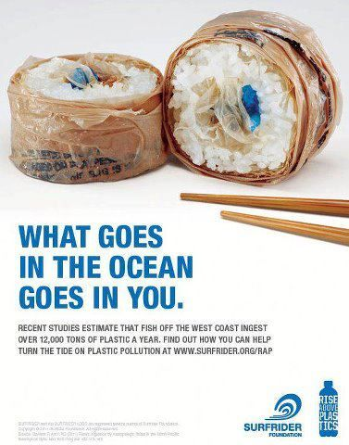
1. Purpose
What is the goal? Are you:
Selling a product
Promoting an event
Promoting research
Evoking an emotional response (Don’t be offensive)
Seeking help/volunteers

Slide 5
2. Concept
Consider your target audience.
How are you going to visually convey your message to them (it should be instantly recognisable).
Browse templates for inspiration if you do not have a concept.

Slide 6
3. Message
Ensure that your message is clear.
Don’t overload with text.
Include essential information only.

Slide 7
4. Colour, Font, Size
Contrasting colours and striking fonts will draw attention to your poster.
Be selective & ensure they work together.
Different fonts or headings are useful to identify different sections.
Use a larger size to distinguish importance.
Source: Business Insider, 250 YEARS OF GENIUS: A Look At The Evolution Of Guinness Advertising
https://www.businessinsider.com/an-evolution-of-guinness-advertising-2012-3?r=US&IR=T#1966-guinness-creates-a-parody-of-the-bayeux-tapestry-10
Notes:
https://www.creativebloq.com/inspiration/print-ads-1233780

Slide 8
Academic Posters
Papachristopoulos, Leonidas, & Tsakonas, Giannis. (2019). More than a Feeling: Insights and Information from a Sentiment Analysis Study. Zenodo. http://doi.org/10.5281/zenodo.3250209

Slide 9
5. Don't over do it
Less is more.
Keep some clean space.
Minimalism is effective in poster design.
Source: Behance.net, Minimalist advertising posters
https://www.behance.net/gallery/59004649/Minimalist-advertising-posters

Slide 10
6. Grouping elements together
Saves A LOT of time when you`re using a lot of different elements e.g. multiple text boxes, or text in shapes.
Allows you to move everything together easily.
Highlight the elements and use CMD+G to create a group.
You need to ungroup the elements to make edits once they have been grouped.

Slide 11
7. Layering
You can use the ‘Position’ controls to move elements into the foreground, send them to the background, or align them to a certain area of the poster.
Layering also is useful to create your own designs/images free from copyright.

Slide 12
8. Uploading images
Canva has loads of excellent high quality images. Some are free but there are also images that you have to pay to use.
Look elsewhere and upload your own image If you cant find what you need for free on Canva.
Pixabay and Freeimages are good providers for images free from copyright.

Slide 13
9. Teamwork
You can create small teams in Canva.
Useful if you`re in a group project as multiple people can access and make edits.
Ensure you trust who you give access to, they can also delete your work!

Slide 14
10. Downloading your product
Multiple file format options available.
I usually download as PNG or JPG, because I have had issues printing with the recommended PDF option.

Slide 15
ul.ie
Contact Library
Email: libinfo@ul.ie
Web/Chat: ul.ie/library
Ask Us: ul-ie.libanswers.com
Social media
ullibrary
ullibrary
LibraryUL

